Slide 1
ANTI SLEEP ALARM
THEME : Accident prevention project
TEAM MEMBERS : SRUTI.D
SHEELA ANGEL.S
SUTHIKA.K

Slide 2
ABSTRACT:
Feeling sleepy while driving could cause hazardaous traffic accident.However,when driving alone on highway or driving over a long period of time,drivers are inclined to feel bored and sleepy,or even fall asleep.
Nowdays most of the products of driver anti-sleep detection sold in the market are simply earphone making intermittent noises,which is quite annoying and inefficient.
As such,there is a high demand for cheap and efficient driver sleep detection.
Therefore,we came up with an idea and successfully developed a sleepy detection and alarming system,which could effectively meet this demand.

Slide 3
MATERIALS REQUIRED:
Ardunio Uno
Ir sensor
Battery
Switch
Transparent glass
Buzzer
Wires

Slide 4
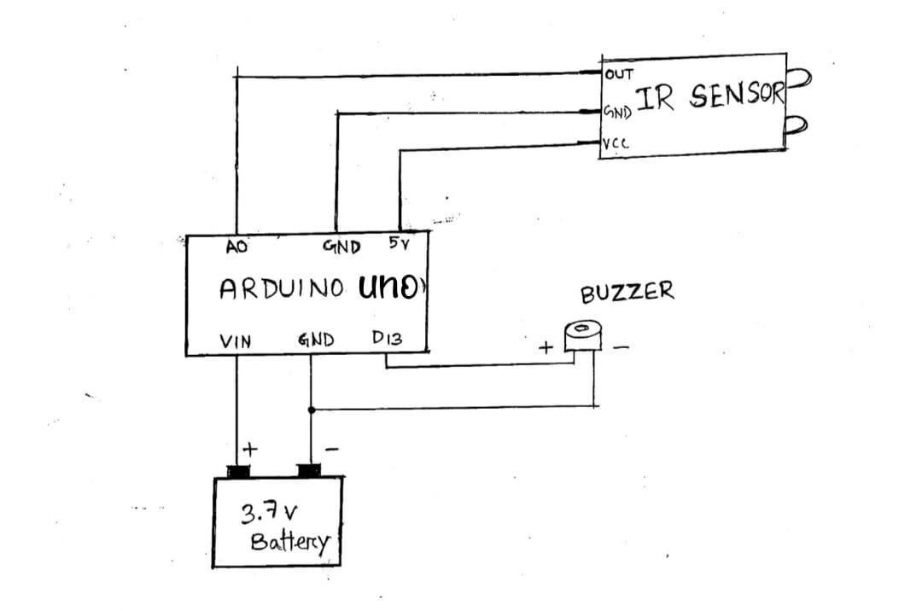
CIRCUIT DIAGRAM:

Slide 5
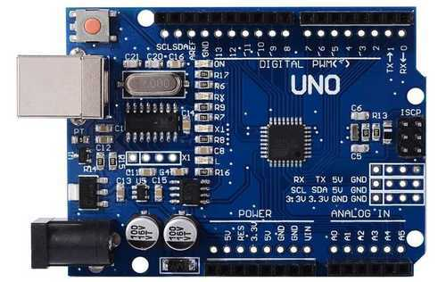
Ardunio Uno:
*The Arduino Uno is an open-source microcontroller board based on the Microchip ATmega328P microcontroller and developed by Arduino.cc and initially released in 2010.
* The board is equipped with sets of digital and analog input/output pins that may be interfaced to various expansion boards and other circuits.

Slide 6
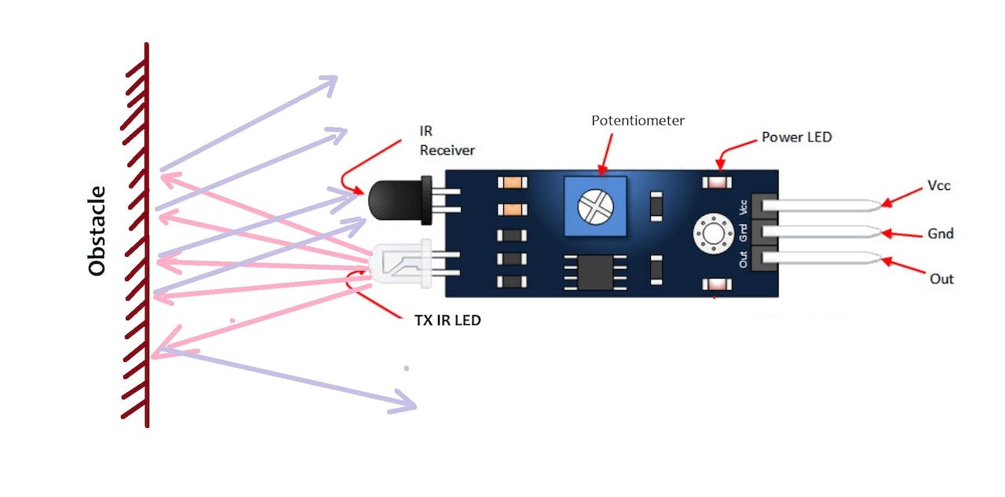
Ir sensor:
*The IR receiver is used to receive the reflected infrared rays of the eyes.
*If the eyes are open then the output of IR receiver is high otherwise the output is low.
*This way the system can understand that the eyes are closed or not.
*This output is channelized to the logic circuit to indicate the alarm.

Slide 7
Working:
The anti sleep alarm uses sensor,to discern a driver’fatigue and correct the problem accordingly.
Sleep pose and activity are determined by sensing data obtained from a three-axis accelerometer sensor.
The buzzer sound alert when the driver starts to fall asleep.

Slide 8
Future implementation of this project:
Recent anti sleep alarms are designed for normal people...,In future we may design a device for people with defected eye.

Slide 9
THANK YOU……

